Slide 1
Classification of Titanic Passenger Data and Chances of Surviving the Disaster
Machine Learning Kaggle Competition
DATA621 FINAL PROJECT
Abdellah AitElmouden | Gabriel Abreu | Jered Ataky | Patrick Maloney

Slide 2
Introduction
The goal of the project was to predict the survival of passengers based off a set of data. We used Kaggle competition "Titanic: Machine Learning from Disaster" (see https://www.kaggle.com/c/titanic/data) to retrieve necessary data and evaluate accuracy of our predictions. The historical data has been split into two groups, a 'training set' and a 'test set'. For the training set, we are provided with the outcome (whether or not a passenger survived). We used this set to build our model to generate predictions for the test set.

Slide 3
Modeling Plan
Data Exploration: summary statistics and simple visualizations were created to search for relationships between the variables.
• Data Preparation: null values were imputed and new features were engineered.
• Logistic Regression Modeling: A binomial logistic regression model was used as an initial comparison for the following model that was simplified using stepwise regression.

Slide 4
Modeling Plan
• Random Forest Modeling: two different random forest functions were used from different packages to be sure we had the best version.
• Evaluation: the test data was then cleaned and run through the models and their performance was
evaluated. Additional tweaks to the models were made in attempt to improve performance.

Slide 5
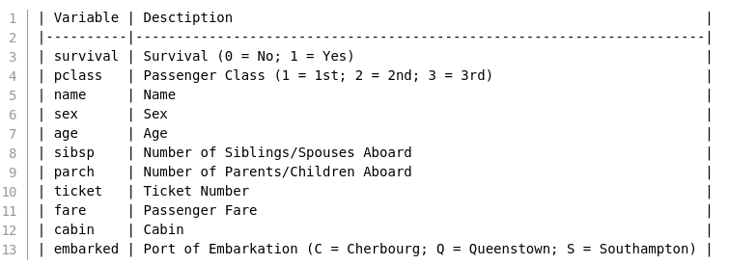
Variable Descriptions

Slide 6
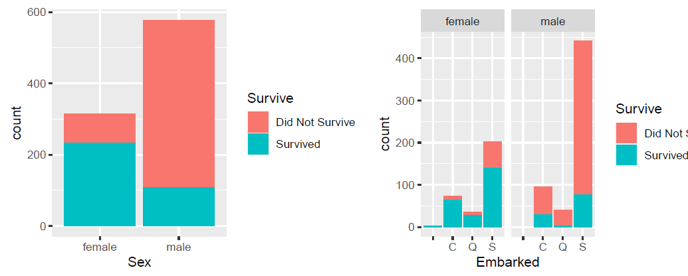
Data Exploration

Slide 7
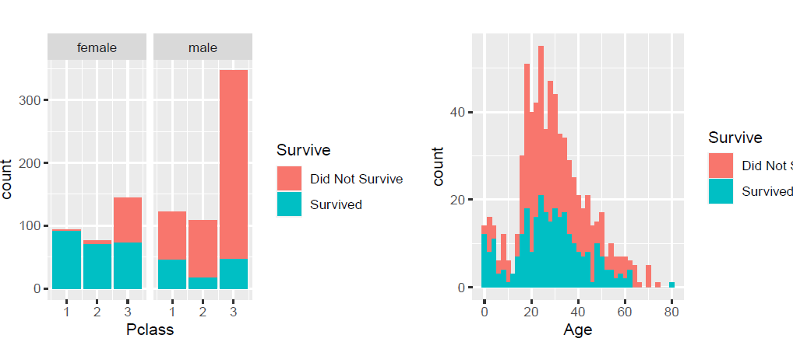
Data Exploration

Slide 8
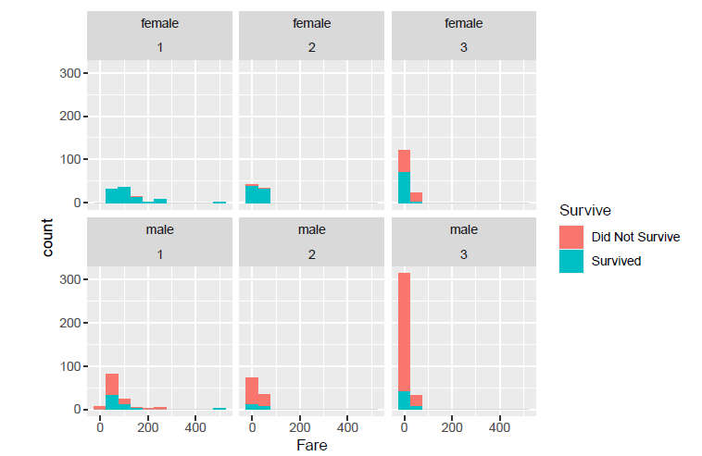
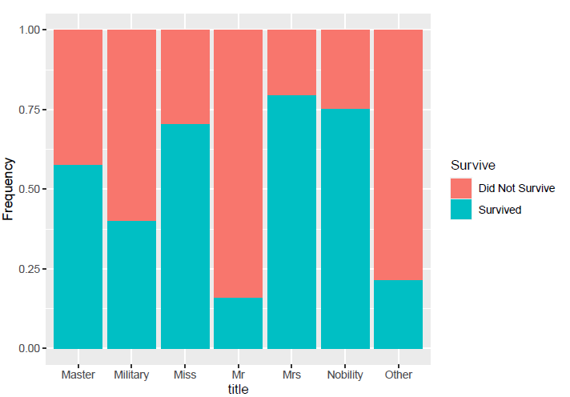
Data Exploration
Based on the visuals, it seemed gender and class had an effect on a passenger’s probability of surviving. We then looked at the titles associated with the passenger’s name.

Slide 9
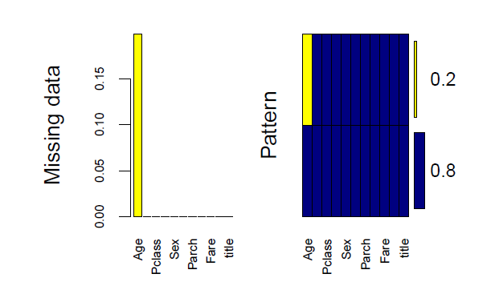
Data Preparation
There are three variables with missing or empty values based on our exploration of the data and visualizations: Embark, Cabin, and Age. Only passengers 62 and 830 are missing their embark ports. We randomly assigned them a value of “C”. The column Cabin had too many missing values to impute or fill, so we dropped the Cabin column from the training data set.
Notes:
From the plot and table, we can see that there are 263 NAs (roughly 20%) in Age variable, We can see that Age was missing nearly 20% of its values. This data was imputed using the rpart function.

Slide 10
Modeling
After exploring the patterns and creating new features, now I will build statistical models to predict the fate of the passengers in the test data set.
Three machine learning methods are used in this project:
- Binomial with logit link function (w/ Imputed data)
- Stepwise regression
- Random Forest

Slide 11
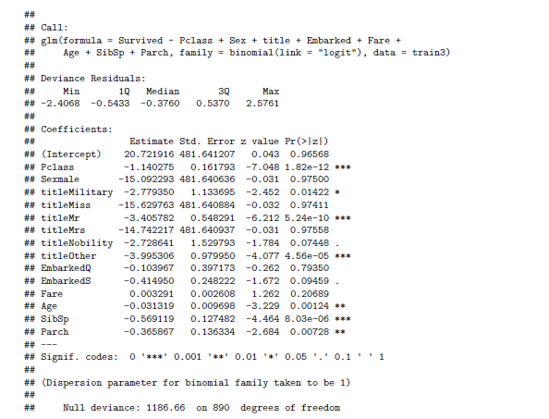
Model 1: Binomial with logit link function
This model is used when the data have binary outcomes. We fit a generalized linear model (binomial with logit link function) with Pclass, Sex, title, Embarked, Fare, Age, SibSp and Parch, as predictors of the number of survived passenger. we can see that Pclass, Sex, Age and SibSp are all significant variables.

Slide 12
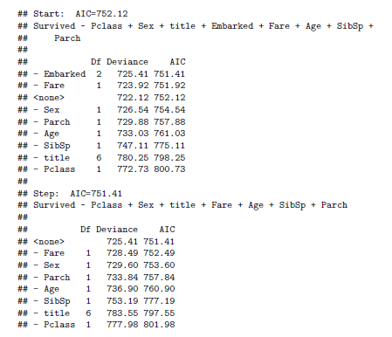
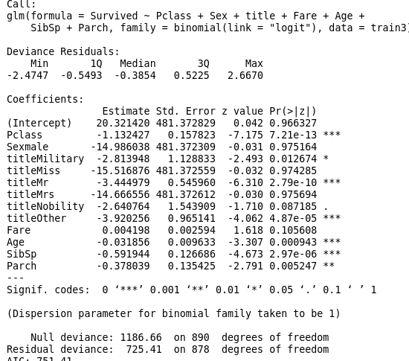
Model 2: Stepwise

Slide 13
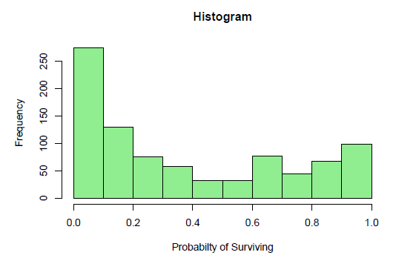
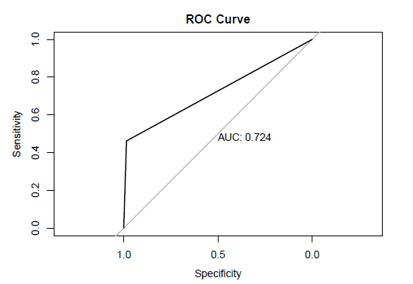
Model 2: Stepwise

Slide 14
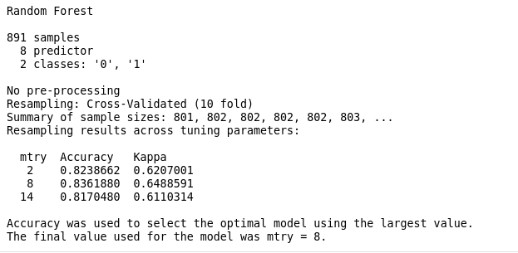
Model 3: Random Forest
Random Forest is our favorite machine learning algorithm so far. We will use the randomForest function from the randomForest package.

Slide 15
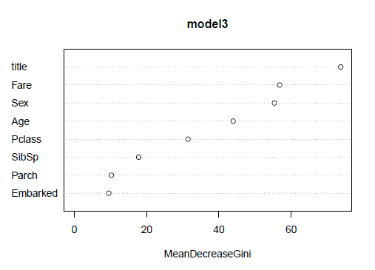
Model 3: Random Forest
The plot shows the importance of the variables judged by the mean decrease accuracy. A variable is considered the most important if the accuracy of the model without it decreased the most compared to the full model.

Slide 16
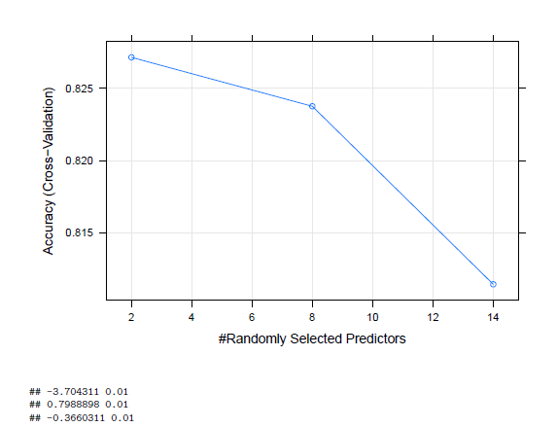
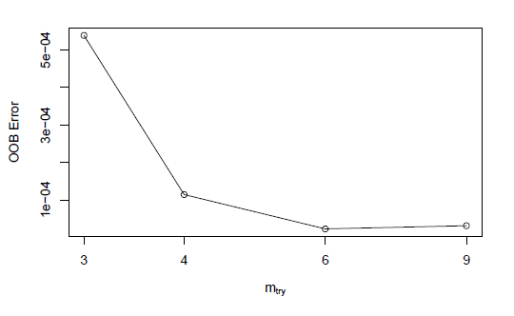
Model 3: Random Forest

Slide 17
Model Selection
The model with the most accurate result is model 2. Tweaking the thresholds changed results on Kaggle but changing the threshold to 0.75 seemed to be optimal (produced score of 0.77511), while the random forest models produced scores of 0.75358.
The models might see greater accuracy testing different methods of imputation. The age column saw the
greatest amount of missing values, focusing on creating accurate age values will most likely improve the
models.

Slide 18
Summary
In this project, We practiced:
Exploratory data analysis with tidyversse, ggplot2, and rpart..etc
We learned Several machine learning algorithms, and modeling with caret, randomForest, and other packages.
Feature Engineering techniques.
We used Rstudio and all the skills and methodologies we learned during this semester.

